Slide 1
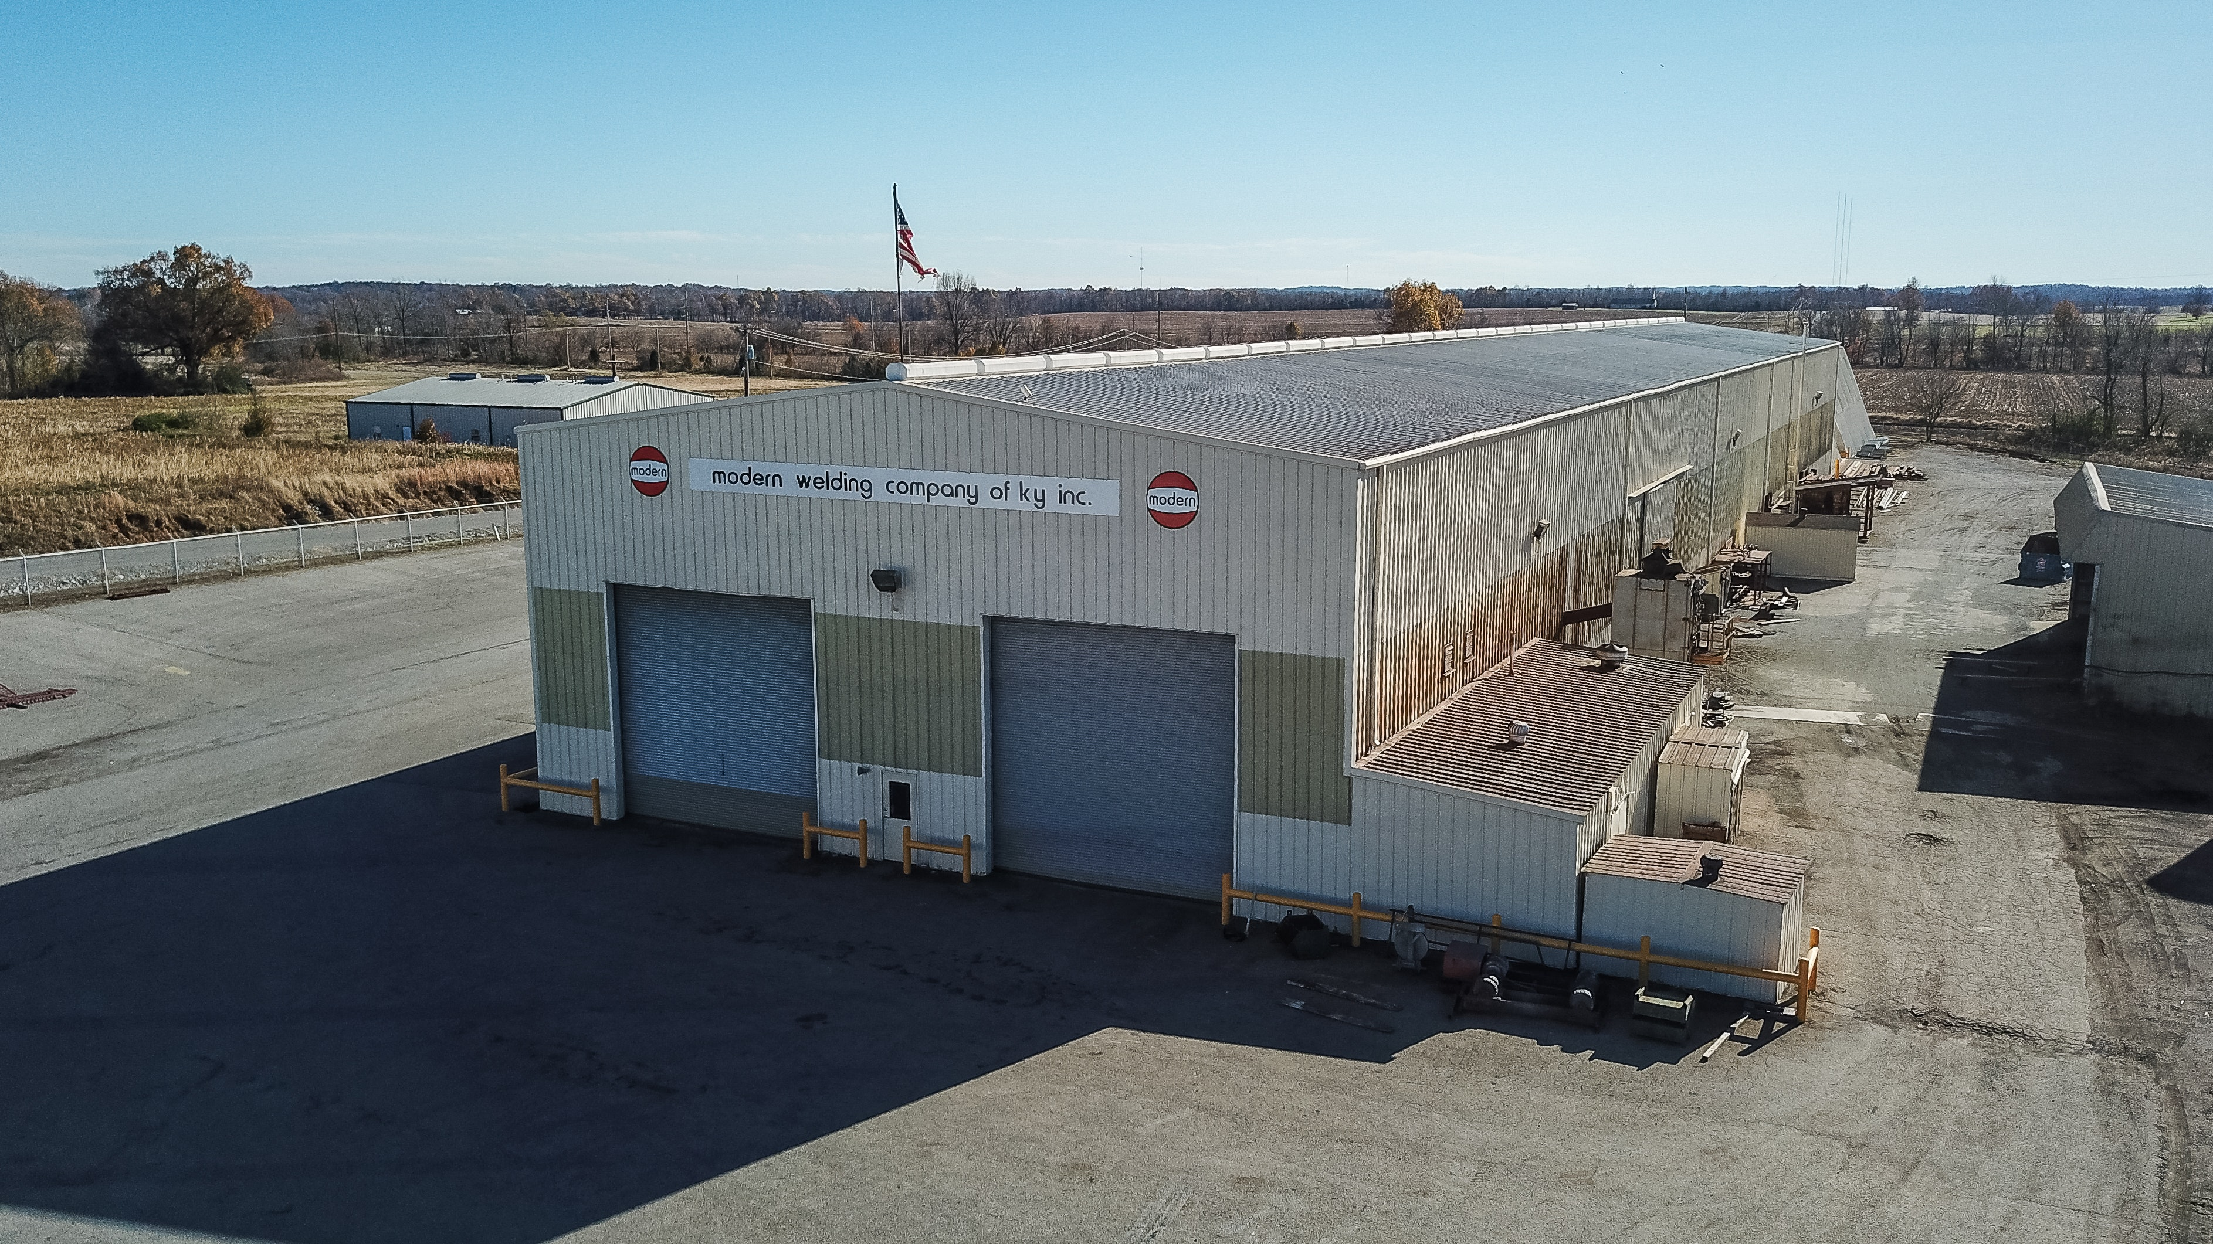
Warehouse Stocks Monitoring
CS 314
IMAGE PROCESSING PRACTICALS W.N.N.V.BANDARA S/18/326
Notes:
https://unsplash.com/photos/AXu2aZ3YgP8

Slide 2

INTRODUCTION
A warehouse stock monitoring system is a software solution that helps warehouses keep track of their inventory.
It provides real-time information about stock levels, automates processes like receiving and updating stock, and generates reports.
By using this system, warehouses can improve inventory management, minimize errors, and increase operational efficiency.
Notes:
https://unsplash.com/photos/fItRJ7AHak8

Slide 3
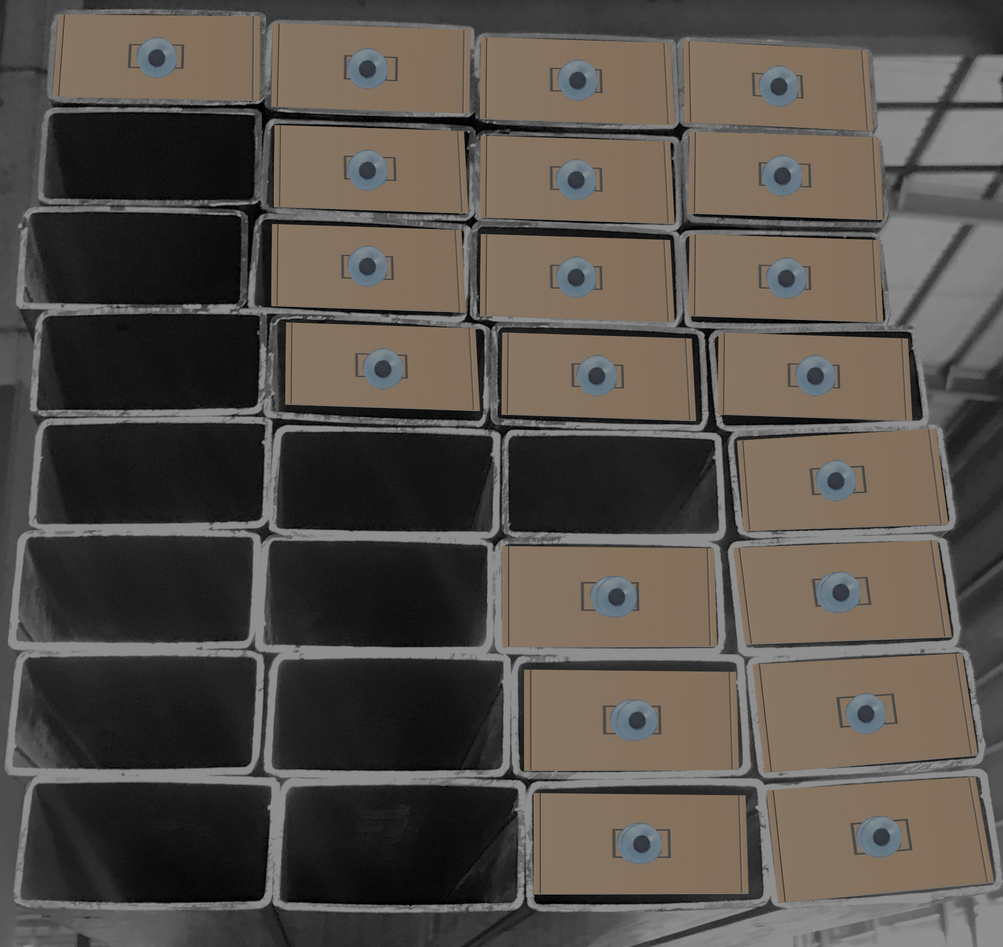
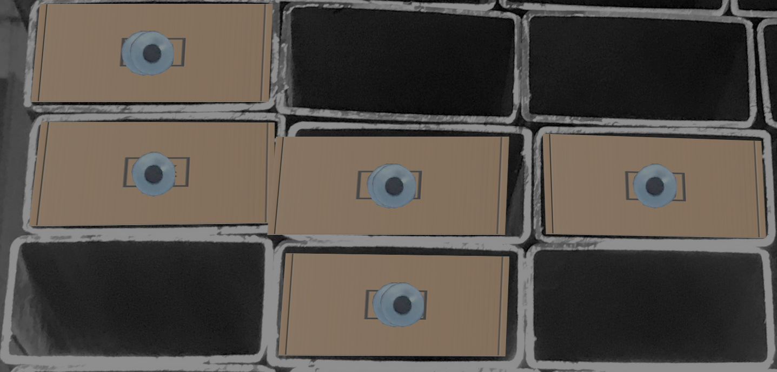
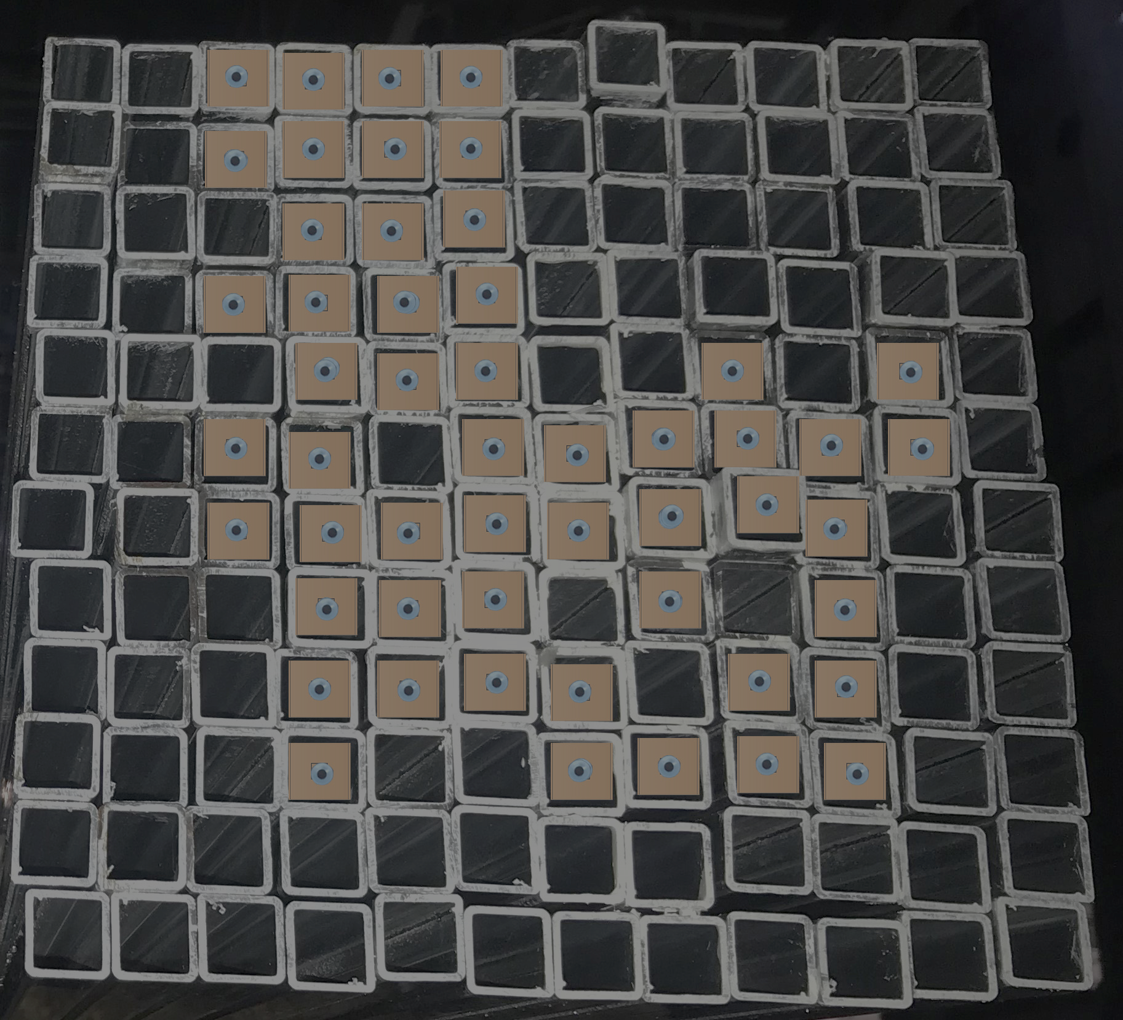

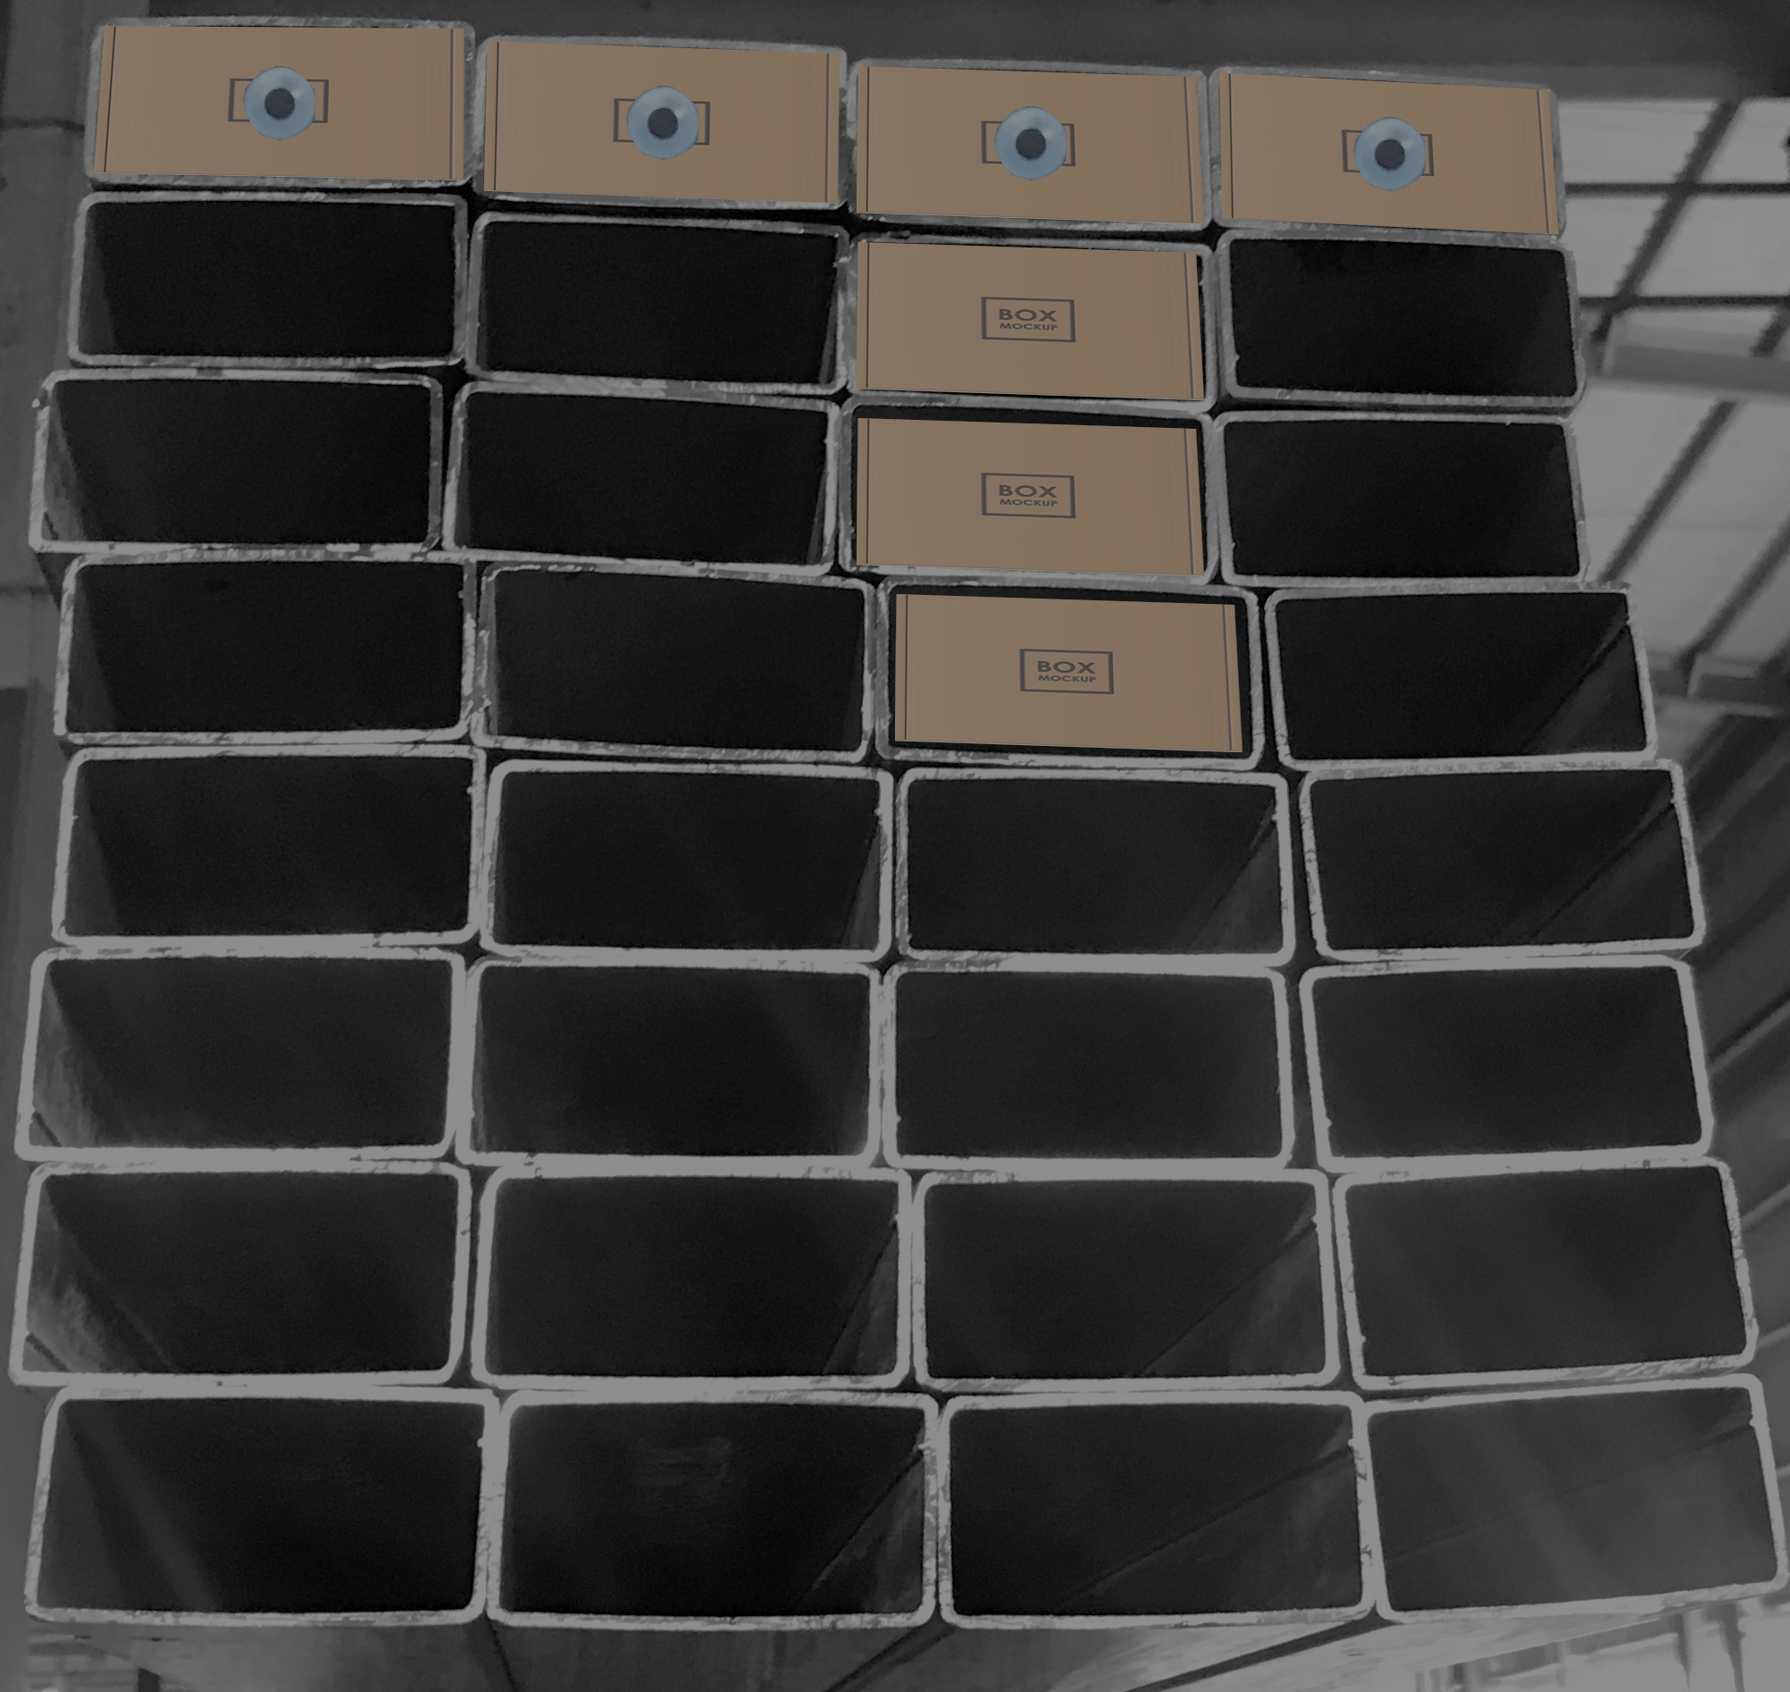
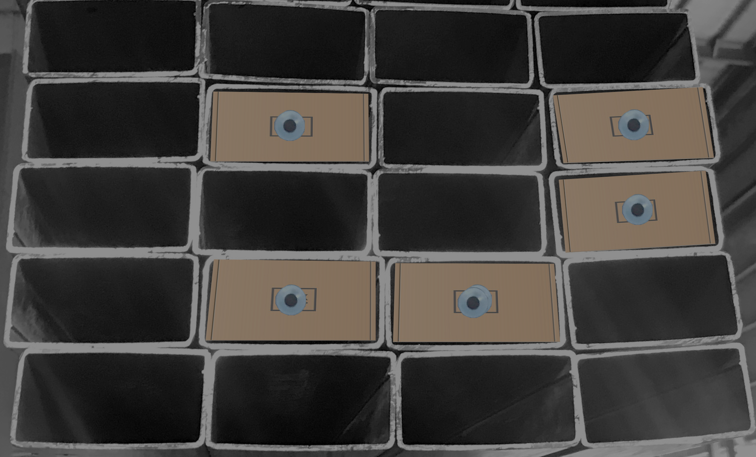
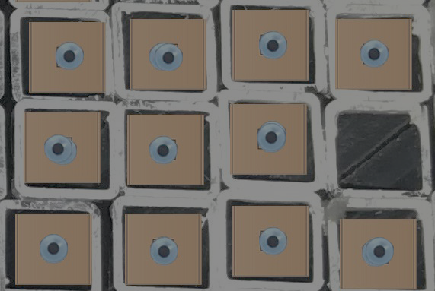
DATASET SAMPLES
Square and Rectangle shape shelves
https://drive.google.com/drive/folders/
1IyGeXFiAVsdZfmfCaP0OW1AgVLanY0ty?usp=drive_link
Notes:
https://unsplash.com/photos/48nerZQCHgo

Slide 4

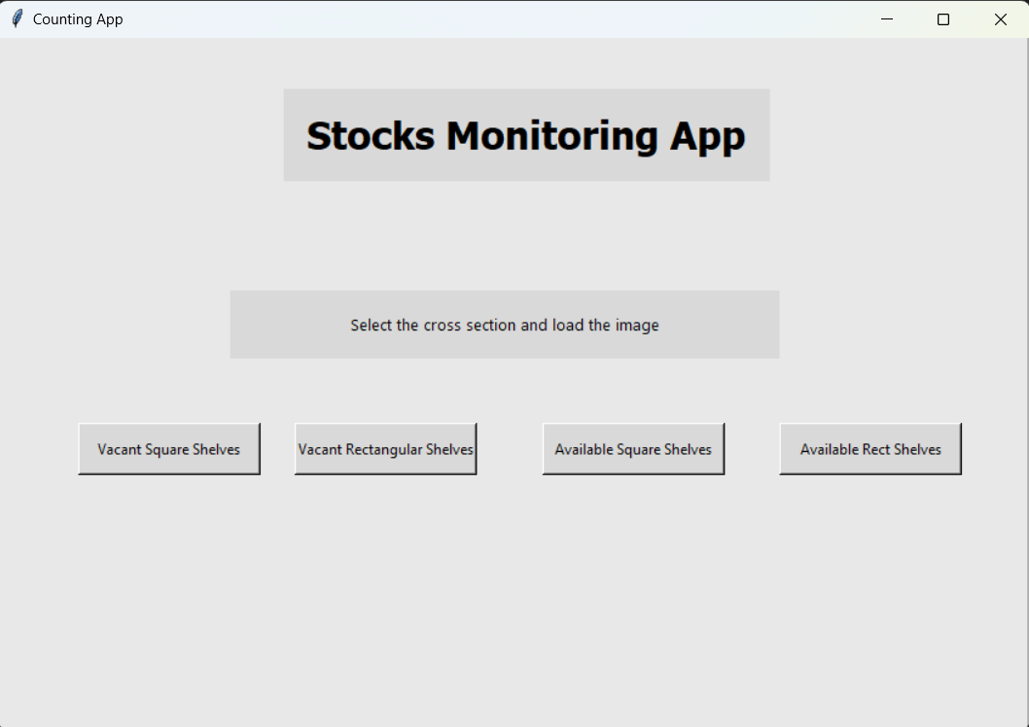
CURRENT STATE
Created different type of shelve images.
Created GUI interface.
Detected and counted available stocks and the vacant storage.
first,Defines the click_and_crop function
(This function is the event handler for mouse events within the image window)
converts the ROI to grayscale
creates a square-shaped kernel (an create rectangle-shape kernel)
applies median blurring to reduce noise
applies thresholding to convert the image to binary
performs dilation on the binary image
applies inverse binary thresholding to the dilated image
finds contours in the image (findContours() function)
Finally, it prints the number of contours detected
Notes:
https://unsplash.com/photos/TvN54bnuQg8

Slide 5
TO DO NEXT
Refinements need to be done to identify the boxes with the same color as the wall.
To make proper GUI finally.
Notes:
https://unsplash.com/photos/TvN54bnuQg8

Slide 6

Issues/challenges encountered
Data Accuracy
Poor image quality can affect the accuracy of monitoring system. It can make object detection, tracking, or analysis more challenging.
Notes:
https://unsplash.com/photos/GKLIsLZxhj0

Slide 7
THANK YOU

